Slide 1
Extract, transform, load
MTN.BI.08
Materialized Views
Elias Nema
Senior Software Engineer
Elias_Nema@epam.com

Slide 2
Agenda
Summaries in DWH
Benefits and Pitfalls of MatViews
Creating Materialized Views
Materialized View Logs
Types of Materialized Views

Slide 3
Summaries in DWH

Slide 4
Summaries
One technique employed in data warehouses to improve performance is the creation of summaries. Summaries are special types of aggregate views that improve query execution times by precalculating expensive joins and aggregation operations prior to execution and storing the results in a table in the database. For example, you can create a summary table to contain the sums of sales by region and by product.

Slide 5
Materialized Views
And in Oracle there is a special object for that – materialized views.
Materialized views can perform a number of roles, such as improving query performance or providing replicated data.

Slide 6
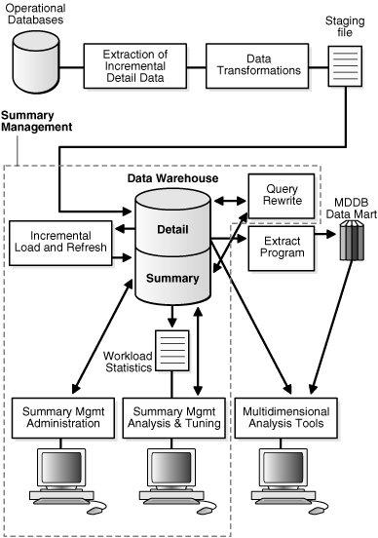
Summary Management
If you identify 20 queries that are commonly applied to the detail or fact tables, then you might be able to satisfy them with five or six well-written materialized views.
Unlike indexes, materialized views can be accessed directly using a SELECT statement. However, it is recommended that you try to avoid writing SQL statements that directly reference the materialized view, because then it is difficult to change them without affecting the application.

Slide 7
Benefits and pitfalls

Slide 8
Benefits
Aggregation processing has already been performed.
Aggregations generally consist of less data; thus a smaller amount of physical space is occupied. Therefore, less I/O is required.
Can be used as a simple form of master to slave replication.
Materialized views are automatically refreshed in various different ways, whereas staging tables would require user or administrator intervention.

Slide 9
And Pitfalls
As with indexes, there is always a danger of creating too many materialized views. Not only would large amounts of physical space be used, but also constant refreshing as a result of overzealous utilization of materialized views could kill performance.
Much more applicable to relatively static data sets.

Slide 10
Creating Materialized Views

Slide 11
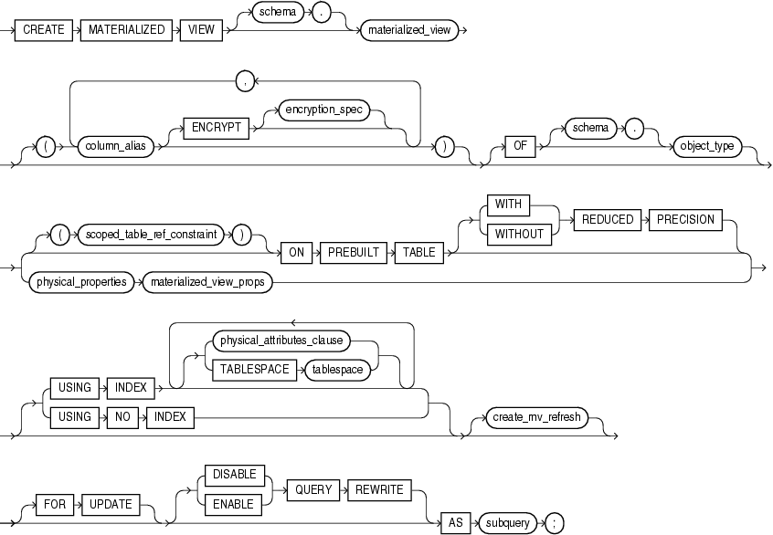
Creating Mat Views

Slide 12
Enable Query Rewrite
Query rewrite can potentially allow an aggregated row set to replace a detailed row set, increasing query performance.
Query rewrite cannot be performed unless all user-defined functions in the materialized view subquery are deterministic and unless all expressions contain repeatable results. For example, SYSDATE is not a repeatable result, because the date is constantly changing.

Slide 13
Verifying Query Rewrite
Not all queries are eligible for query rewrite, and some that you might expect to execute query rewrite on a materialized view might not actually execute query rewrite at all. As a result, we need to have methods of verifying query rewrite.
There are various methods of verifying the occurrence of query rewrite, such as using the DBMS_MVIEW.EXPLAIN_MVIEW procedure.

Slide 14
On Prebuilt Table
CREATE TABLE sales_by_region(
region VARCHAR2(32)
,amount NUMBER(10,2));
CREATE MATERIALIZED VIEW sales_by_region
ON PREBUILT TABLE WITH REDUCED PRECISION
ENABLE QUERY REWRITE
AS SELECT l.region AS region
, SUM(s.transaction_amount) AS amount
FROM sale s, location l
WHERE s.location_id = l.location_id
GROUP BY l.region;

Slide 15
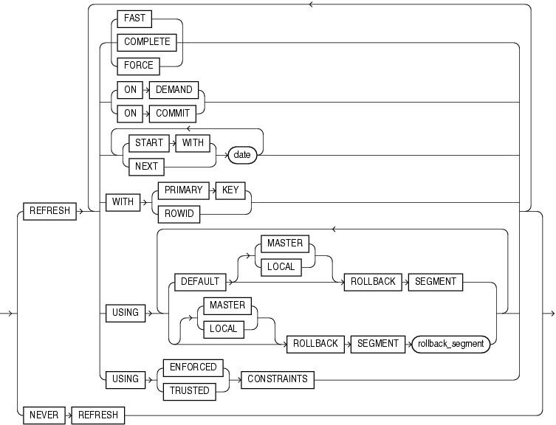
Refresh

Slide 16
Materialized View Logs

Slide 17
Materialized View Log
A materialized view log object is required to allow for incremental fast refresh on materialized views undergoing DML statement changes. Log entries must be referenced by something between underlying tables, materialized view and materialized view log. The WITH clause is used to define the reference.
Changes for fast refresh are stored in materialized view logs in much the same way that they are stored in redo logs, allowing for future rebuilding of a materialized view similar to log entry recovery of datafiles.

Slide 18
Example
CREATE MATERIALIZED VIEW LOG ON sale
WITH PRIMARY KEY
, ROWID
, SEQUENCE(location_id, transaction_amount)
INCLUDING NEW VALUES;
The Oracle Corporation recommends that the SEQUENCE keyword be used in order to add sequencing information to the logs, for individual columns in materialized views.

Slide 19
Types of Materialized Views

Slide 20
M*Views Types
Aggregates or filtering, or both aggregation and filtering
Joins
Set operator queries using operators such as UNION or INTERSECT
Nesting where one materialized view contains another materialized view
Any combination of the above

Slide 21
Single Table Aggregations and Filtering
There is no point in creating a materialized view that excludes both aggregation and filtering, as it would simply mirror the underlying table.
CREATE MATERIALIZED VIEW mv_sale AS
SELECT location_id, COUNT(location_id)
FROM sale
WHERE sale_id < 100000 GROUP BY location_id;

Slide 22
Join Materialized Views
Commonly materialized views are used to store aggregated query results, but they can be used to store joins where no aggregation is involved.
Clusters have been used in the past to store precalculated joins. Additionally, a cluster cannot be automatically updated as a materialized view can.

Slide 23
Easy Reminder
The most sensible use of a materialized view is in a data warehouse, and in a situation where I/O is reduced by reading aggregated data. The additional factor of reading information from a preconstructed join as a materialized view can help to reduce SQL code performance in join execution but not necessarily I/O activity.
Therefore, materialized views should never be created from the perspective of what can be speeded up but from what end users most commonly require in terms of reporting performance.

Slide 24
Nested Materialized Views
Materialized views can be nested such that one materialized view can access another materialized view.
One the most effective tricks of materialized view nesting is to create a single join materialized view between a single fact table and its related dimensions (a single star schema) and create single table aggregation materialized views on the join materialized view.

Slide 25
ORDER BY Clause
A materialized view creation query can contain an ORDER BY clause. The ORDER BY clause will help to physically sequence data. However, materialized views are maintained by underlying tables, and underlying tables are not necessarily sorted in the sequence of the ORDER BY clause.
The materialized view ORDER BY clause sort order is not used during refresh.
If the materialized view initial creation ORDER BY clause matches sorting requirements when queries execute query rewrite operations through the materialized view, that ORDER BY sorting will certainly help query performance.

Slide 26
Materialized Views
Elias Nema
Senior Software Engineer
Elias_Nema@epam.com

